Slide 1
Sovling CTF with Pyton
Name : 派德曼
Teacher :

Slide 2
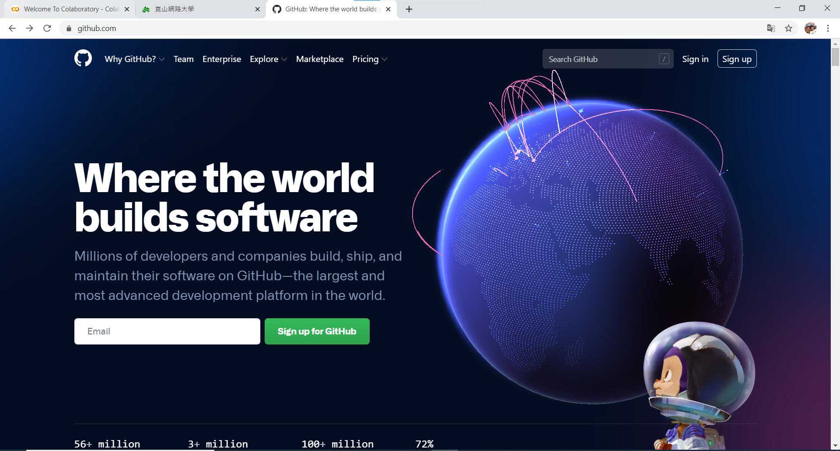

Slide 3
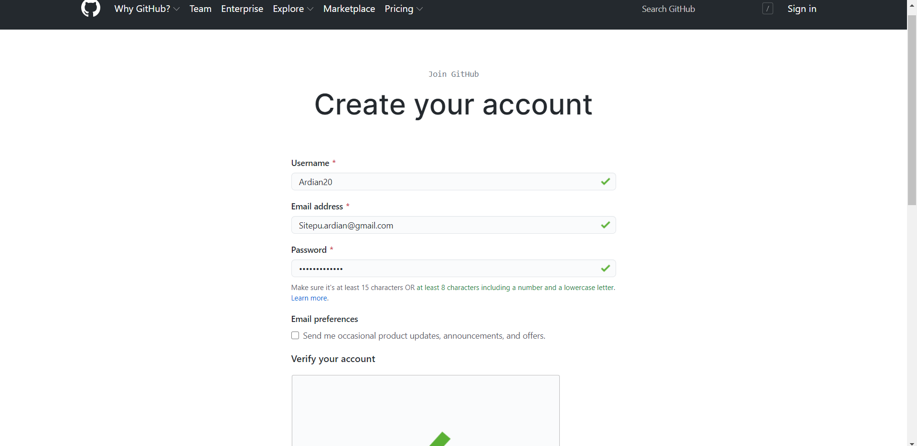

Slide 4
mydeargreatteacher

Slide 5
